Slide 1



Blockchain, shaping the future of Internet
Hackers Week - 10.04.2019

Slide 2

¿Quiénes somos?
José Ramón Gil Cotaína
Agile Coach en Thomas Cook Team
Daniel García Acosta
Technical Lead en Thomas Cook Team
Santiago Sánchez
Intern en Thomas Cook Team
Cristina Quintanilla
Employer Branding Specialist en Ciklum Málaga
Blockchain, shaping the future of Internet
Page ‹#›
Notes:
Cris
‹#›

Slide 3

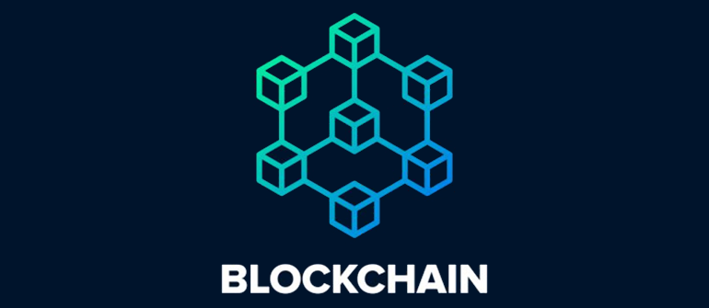

¿Qué os vamos a contar?

Slide 4
AGENDA
¿Cúal es el problema?
Problema
Origen
Arquitectura
Minado
Smart-Contracts
Criptomonedas
Casos de Uso
Práctica
Caso de Uso
Crear Smart-Contract
Desplegar Smart-Contract
Comprobar Transacciones
Blockchain, shaping the future of Internet
Page ‹#›
Notes:
‹#›

Slide 5
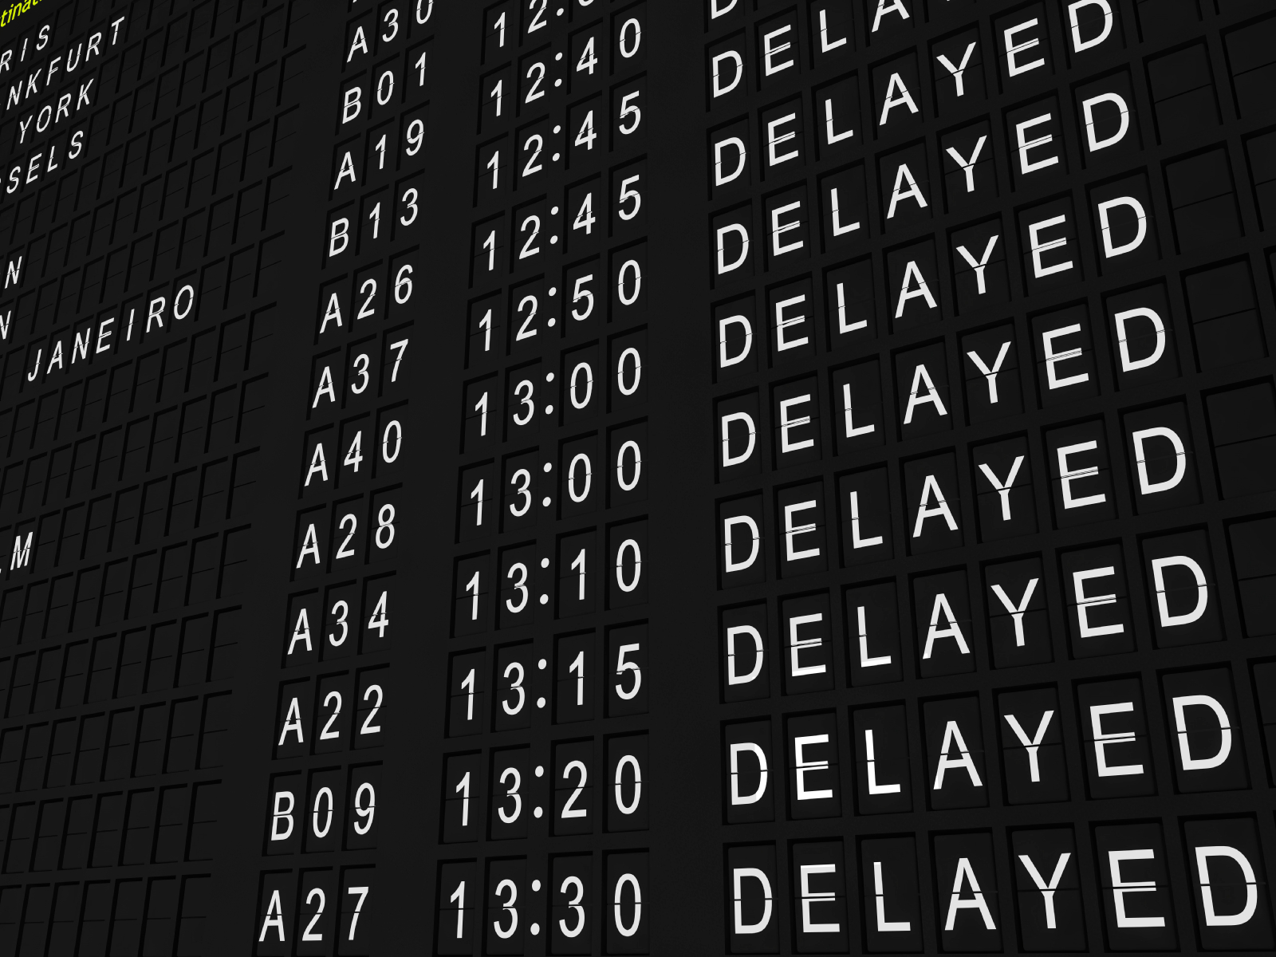
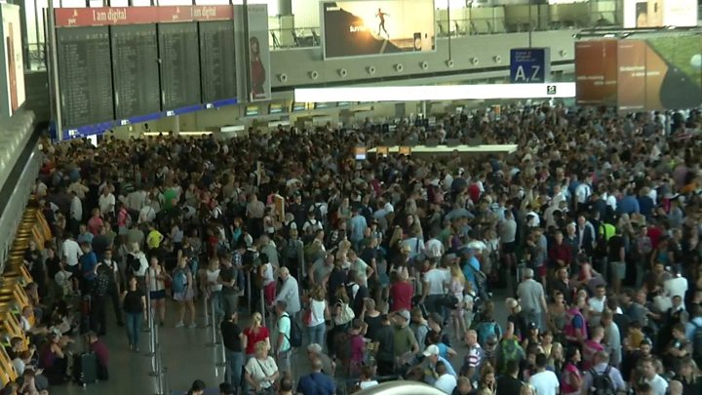
Problema
Blockchain, shaping the future of Internet
Page ‹#›
Notes:
Santi - interaccion
‹#›

Slide 6
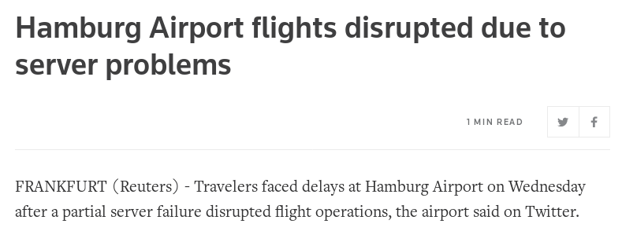
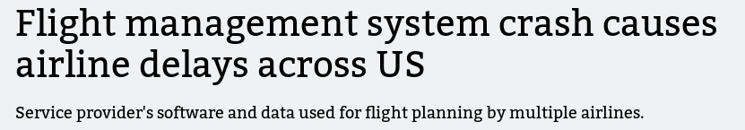
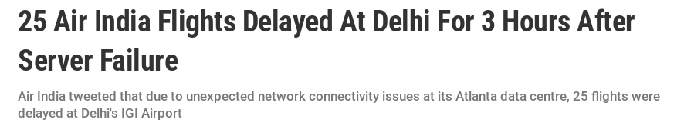
Origen
¿Cual es el problema?
Blockchain, shaping the future of Internet
Page ‹#›
Notes:
Santi
‹#›

Slide 7





Posible solución
PaaS y SaaS
Blockchain, shaping the future of Internet
Page ‹#›
Notes:
Santi
‹#›

Slide 8
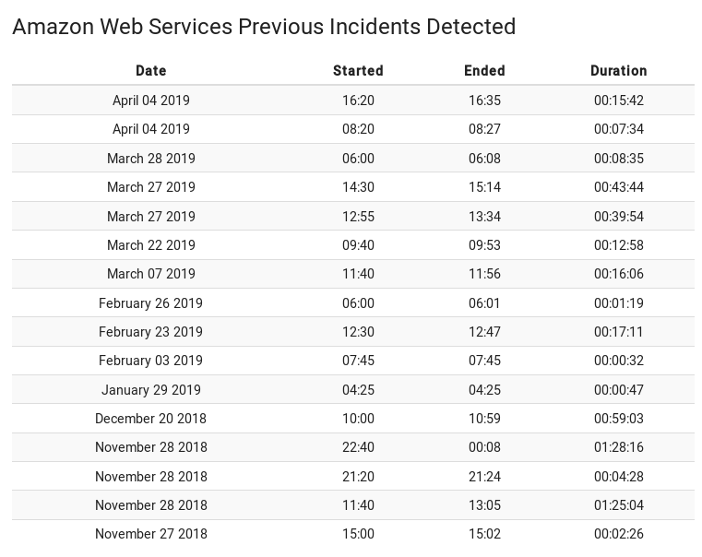
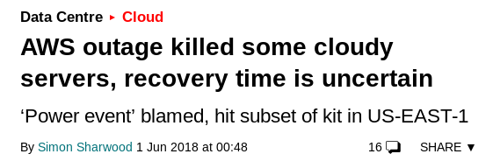
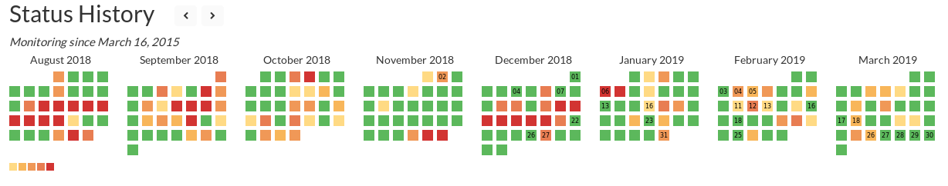
Posible solución
¡Tampoco nos sirve!
Blockchain, shaping the future of Internet
Page ‹#›
Notes:
Santi
‹#›

Slide 9
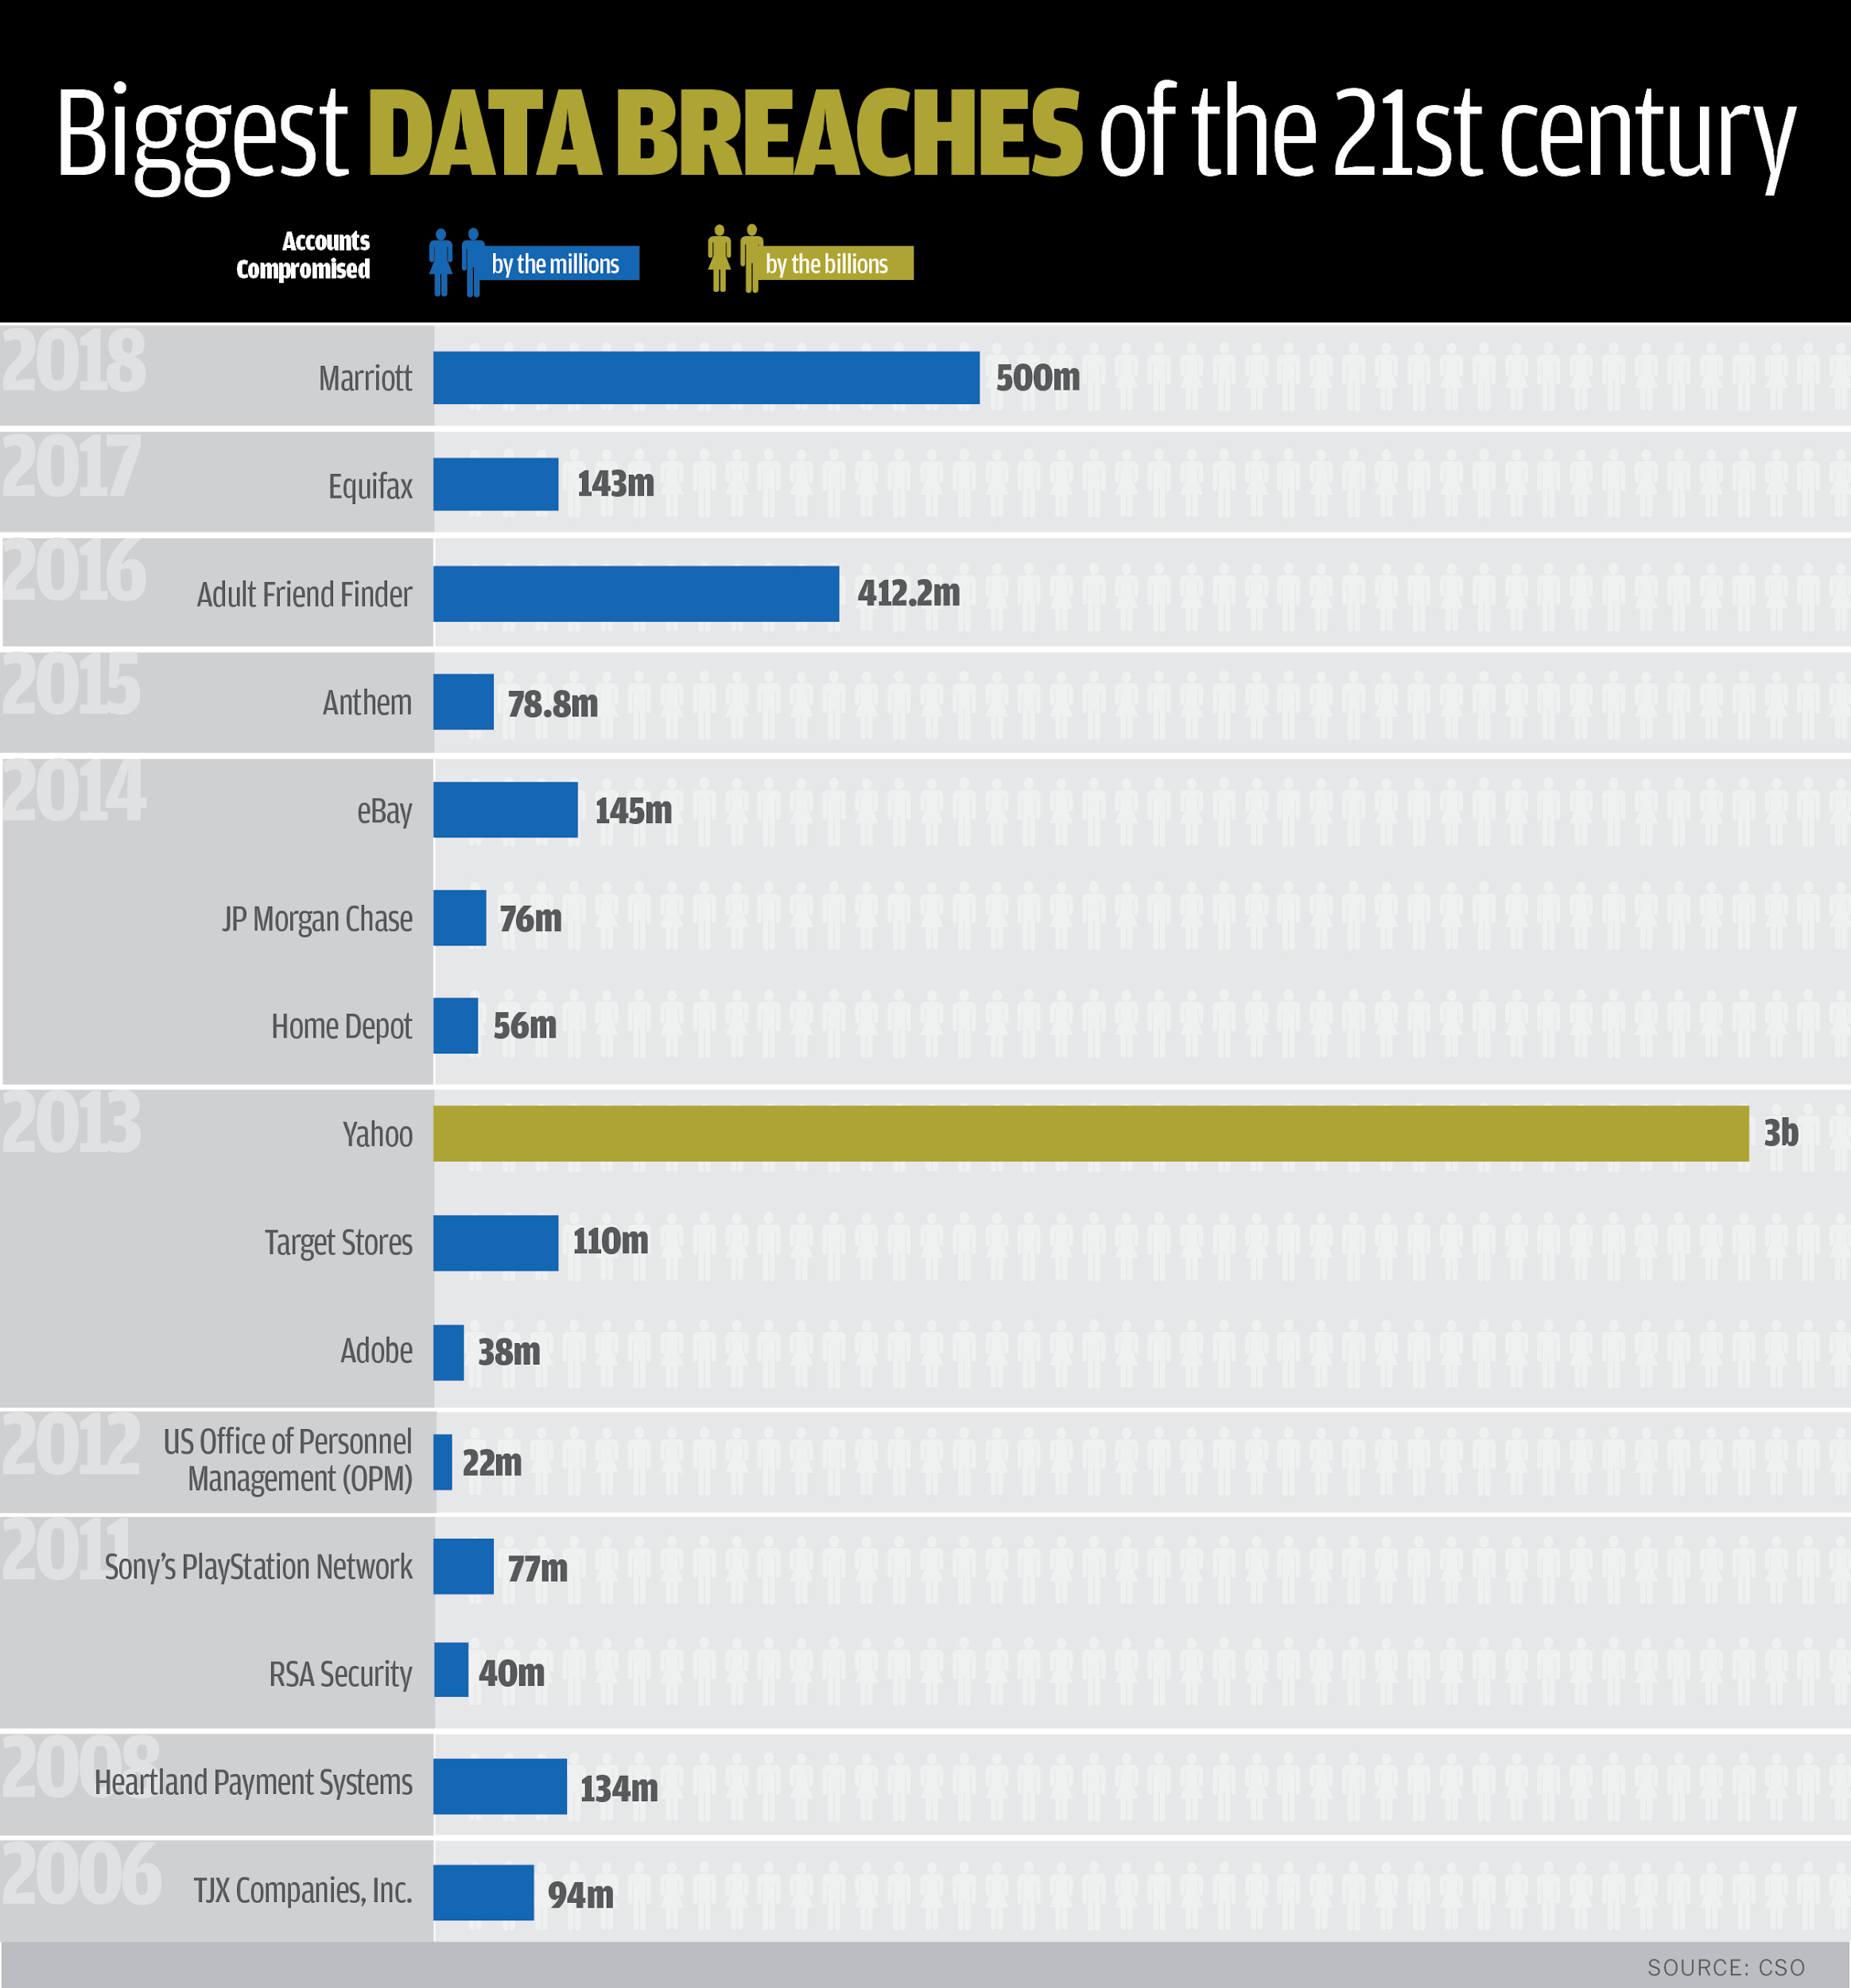
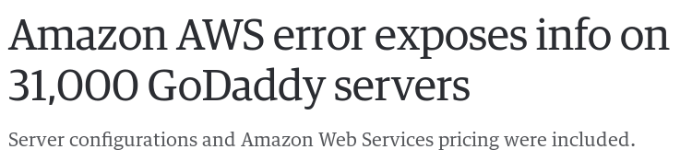
Y ya no es sólo que se caiga...
También tenemos que tener en cuenta la seguridad
Blockchain, shaping the future of Internet
Page ‹#›
Notes:
Santi
‹#›

Slide 10
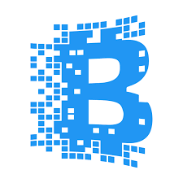

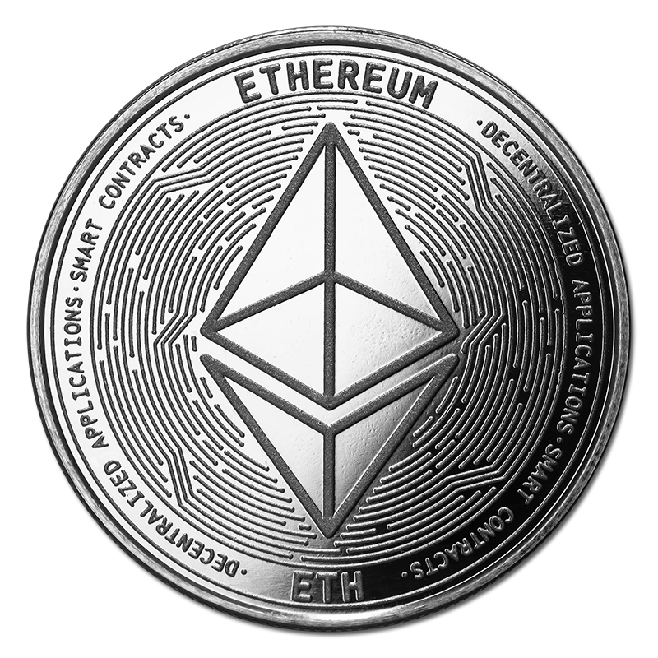

Origen
Contexto/Origen
BLOCKCHAIN
ETHEREUM
ETHER
Blockchain, shaping the future of Internet
Page ‹#›
Notes:
Dani --- interaccion
Blockchain - Technology (theory, concepts)
Ethereum - Implementation of technology (distributed network)
Ether - DApp on Ethereum that is a currency
‹#›

Slide 11
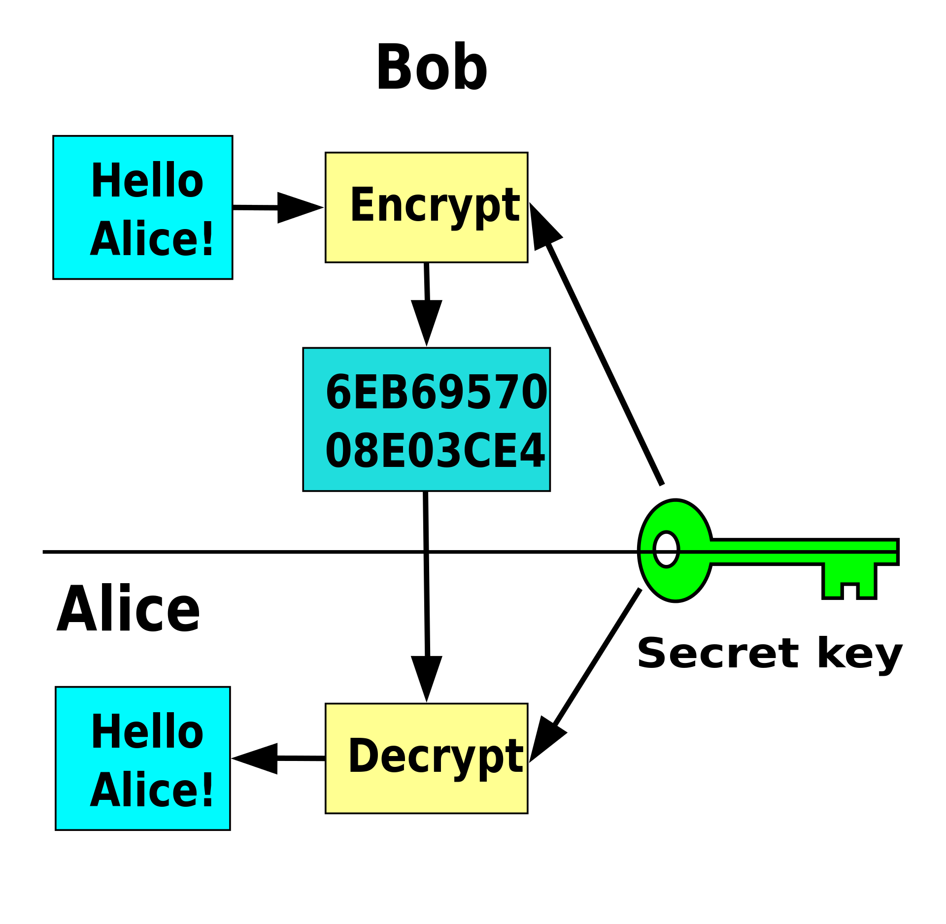
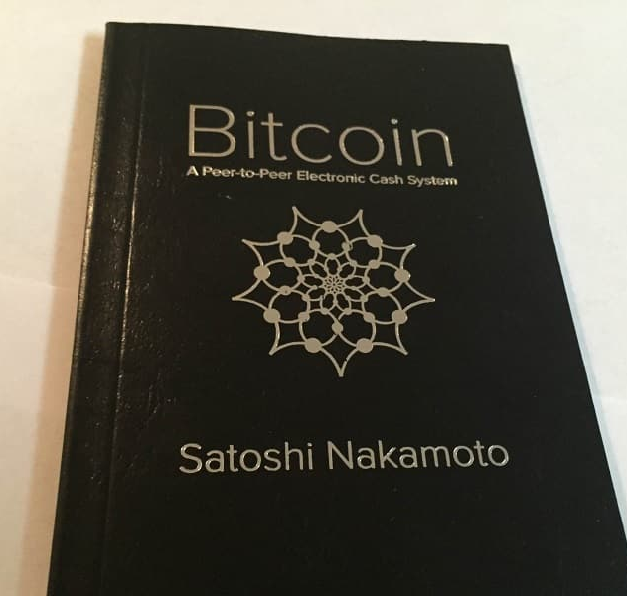
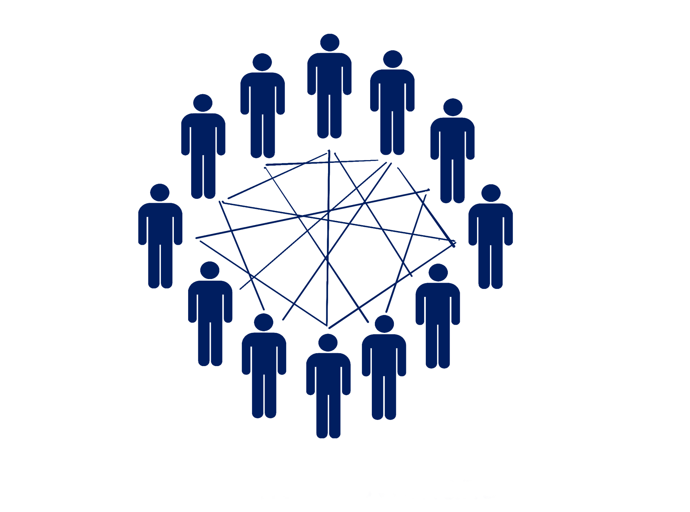
Origen
Contexto/Origen
Criptografía
Peer-to-Peer
Manifesto Cripto-anarquista
Bitcoin Whitepaper
P2P
La cripto anarquia alterara completamente la naturaleza de regulacion del gobierno, la habilidad de controlar iteraciones economicas e impuestos, la habilidad de mantener la informacion secreta
Tim C. May
Self Governance
Blockchain, shaping the future of Internet
Page ‹#›
Notes:
Dani The Crypto-anarchist manifesto: https://www.activism.net/cypherpunk/crypto-anarchy.html
‹#›

Slide 12
Arquitectura
Self Governance
Blockchain, shaping the future of Internet
Page ‹#›
Notes:
Dani The Crypto-anarchist manifesto: https://www.activism.net/cypherpunk/crypto-anarchy.html
‹#›

Slide 13
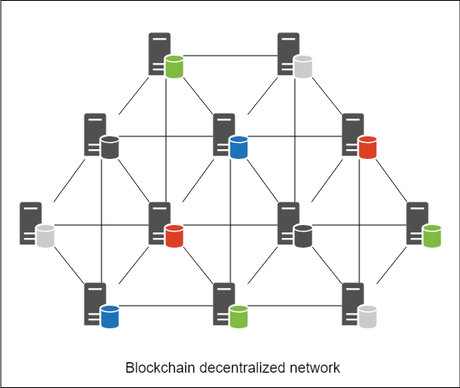
Arquitectura
Contexto/Arquitectura
Red Descentralizada y Distribuida
Blockchain, shaping the future of Internet
Page ‹#›
Notes:
Jose
‹#›

Slide 14
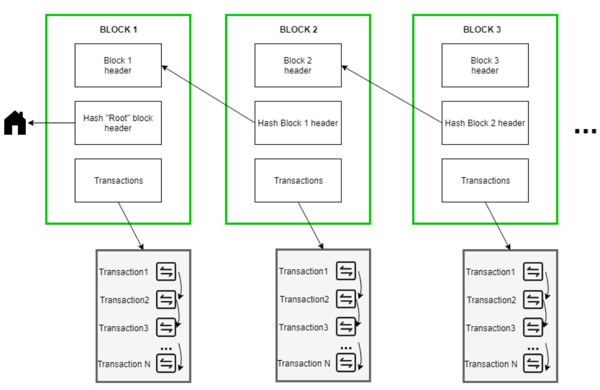
Arquitectura
Contexto/Arquitectura
Blockchain, shaping the future of Internet
Page ‹#›
Notes:
Jose
‹#›

Slide 15
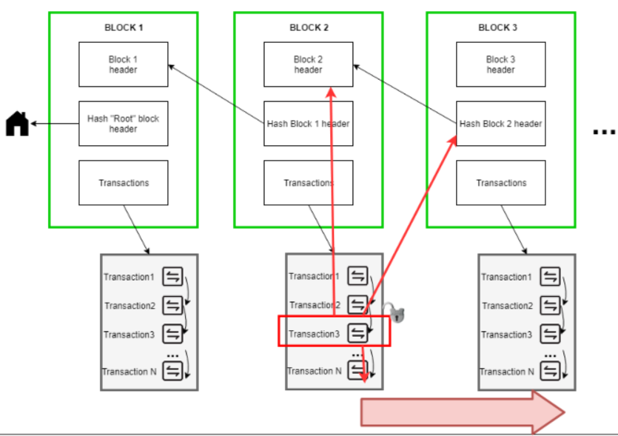
Arquitectura
Contexto/Arquitectura
Blockchain, shaping the future of Internet
Page ‹#›
Notes:
Jose
‹#›

Slide 16
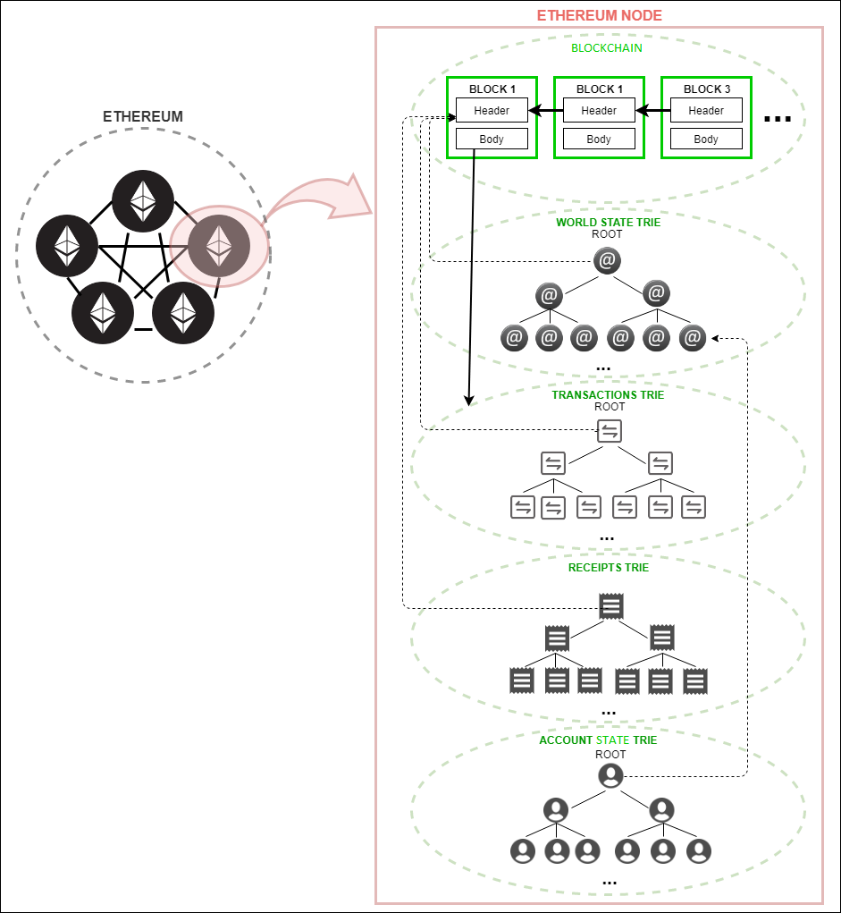
Arquitectura
Contexto/Arquitectura
Blockchain, shaping the future of Internet
Page ‹#›
Notes:
Jose
‹#›

Slide 17
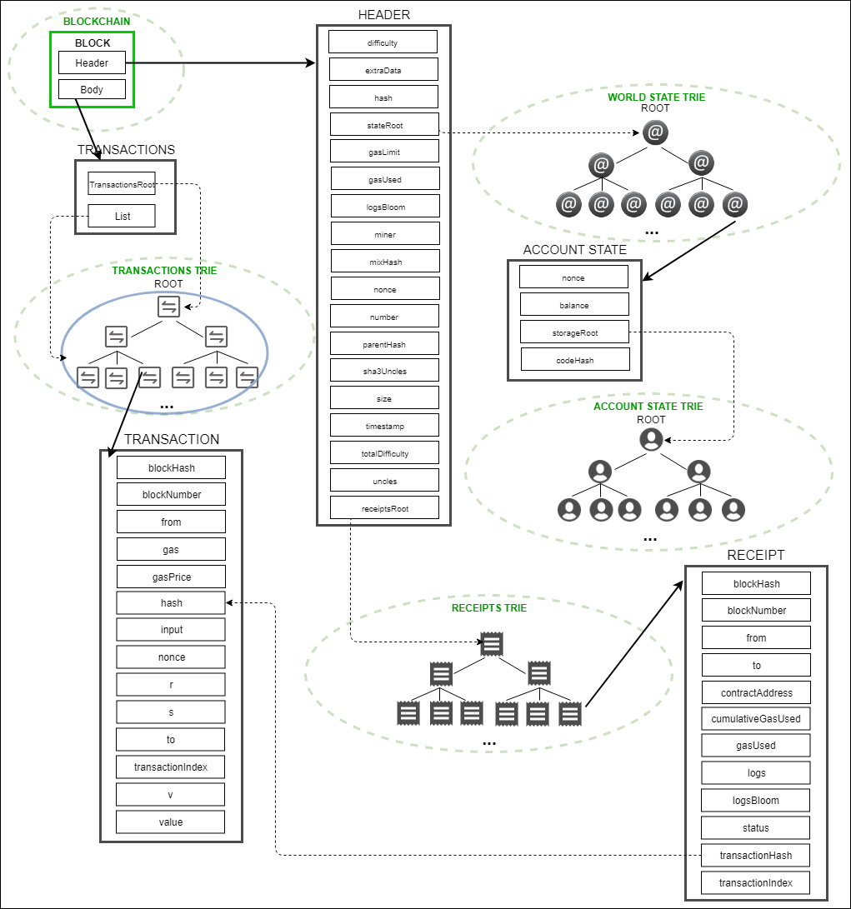
Arquitectura
Contexto/Arquitectura
Blockchain, shaping the future of Internet
Page ‹#›
Notes:
Jose
‹#›

Slide 18
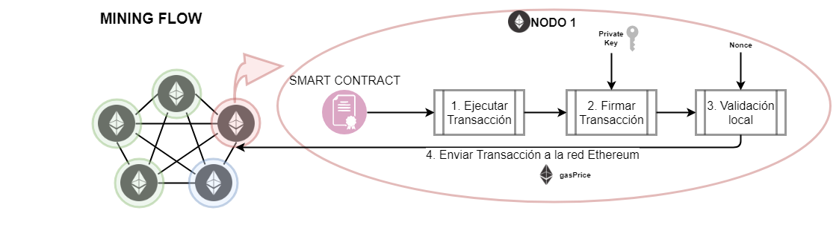
Minado
Contexto/Minado
Blockchain, shaping the future of Internet
Page ‹#›
Notes:
Jose Explicar el flujo, gas, value, proof-of-work, proof-of-stake? (https://blockgeeks.com/guides/proof-of-work-vs-proof-of-stake/)
‹#›

Slide 19
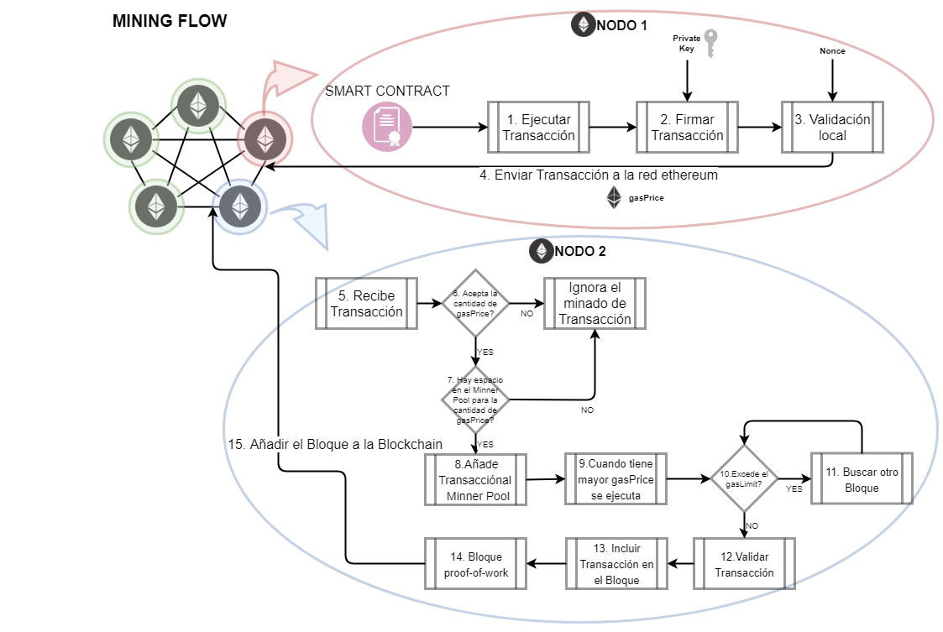
Minado
Contexto/Minado
Blockchain, shaping the future of Internet
Page ‹#›
Notes:
Jose Explicar el flujo, gas, value, proof-of-work, proof-of-stake? (https://blockgeeks.com/guides/proof-of-work-vs-proof-of-stake/)
‹#›

Slide 20
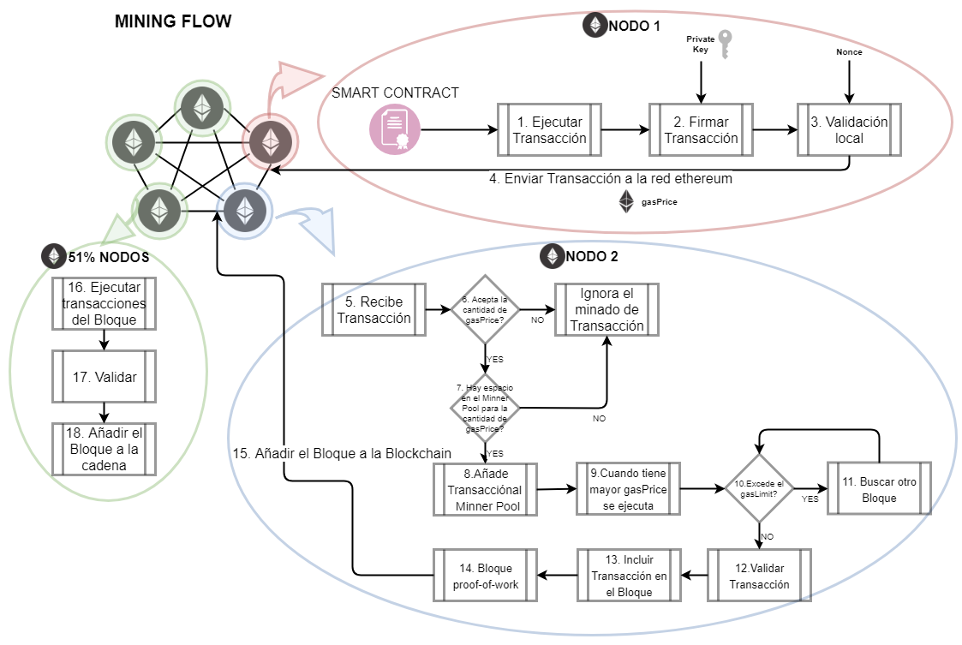
Minado
Contexto/Minado
Blockchain, shaping the future of Internet
Page ‹#›
Notes:
Jose Explicar el flujo, gas, value, proof-of-work, proof-of-stake? (https://blockgeeks.com/guides/proof-of-work-vs-proof-of-stake/)
‹#›

Slide 21
Smart-Contract
Smart-Contract
Contexto/Smart-Contract
3
Ethereum
2
Blockchain
1
Blockchain, shaping the future of Internet
Page ‹#›
Notes:
Jose
‹#›

Slide 22
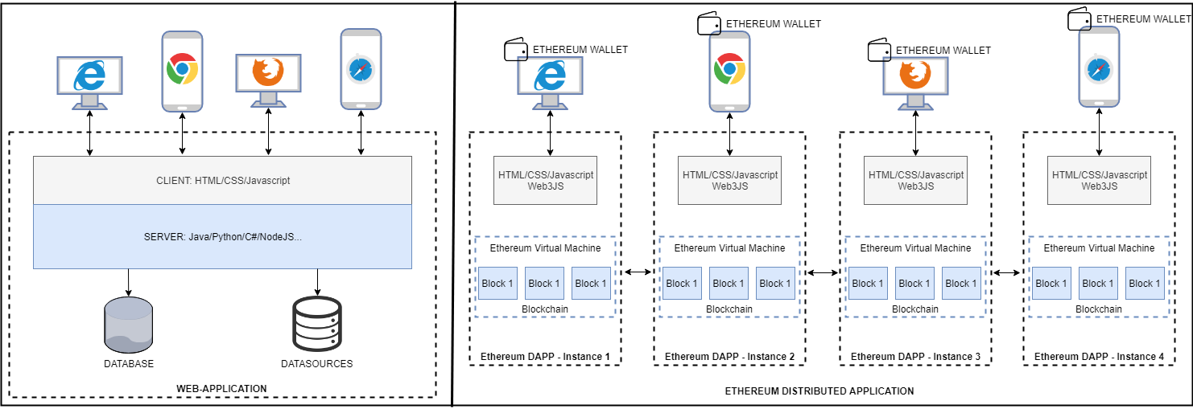
Smart-Contract
Contexto/Smart-Contract
Blockchain, shaping the future of Internet
Page ‹#›
Notes:
Jose
‹#›

Slide 23
Juguemos!
715748
kahoot.it
Blockchain, shaping the future of Internet
Notes:
Jose - https://create.kahoot.it/create#/edit/9727f7da-50a5-4c0f-a502-e6c2b8aebe57/overview

Slide 24
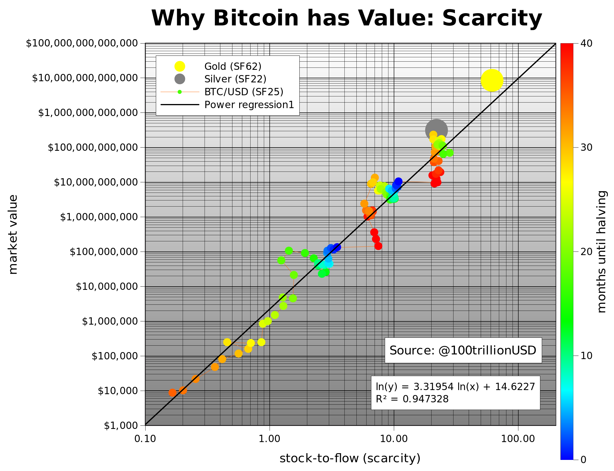
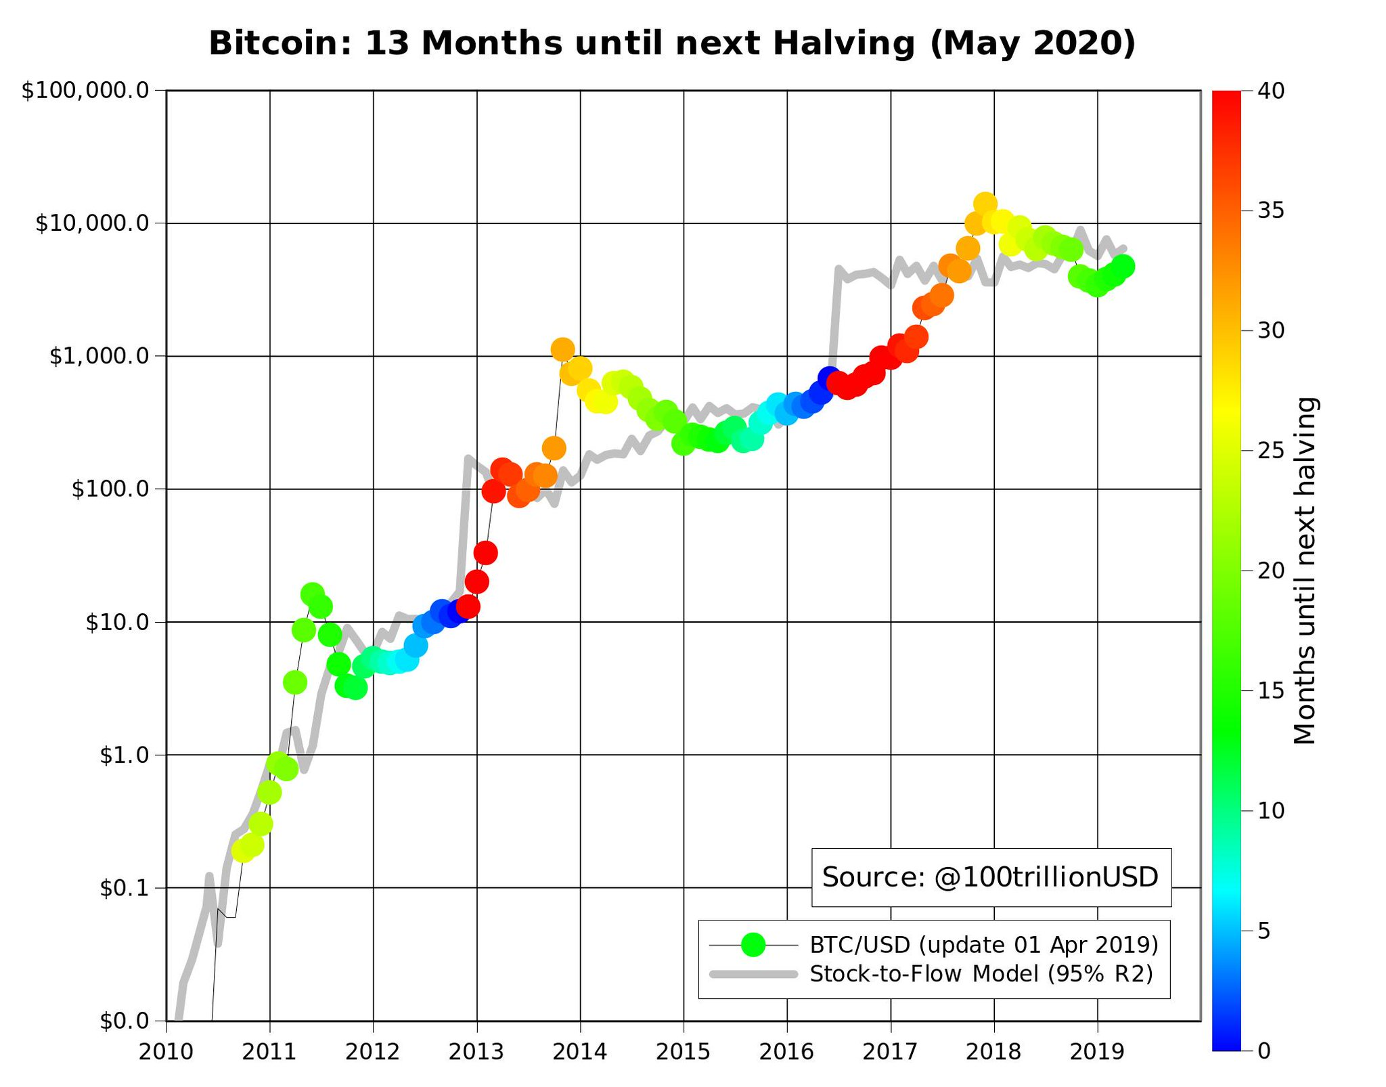
Value
https://twitter.com/100trillionusd https://medium.com/@100trillionUSD
Blockchain, shaping the future of Internet
Page ‹#›
Notes:
Dani ----- premio
‹#›

Slide 25
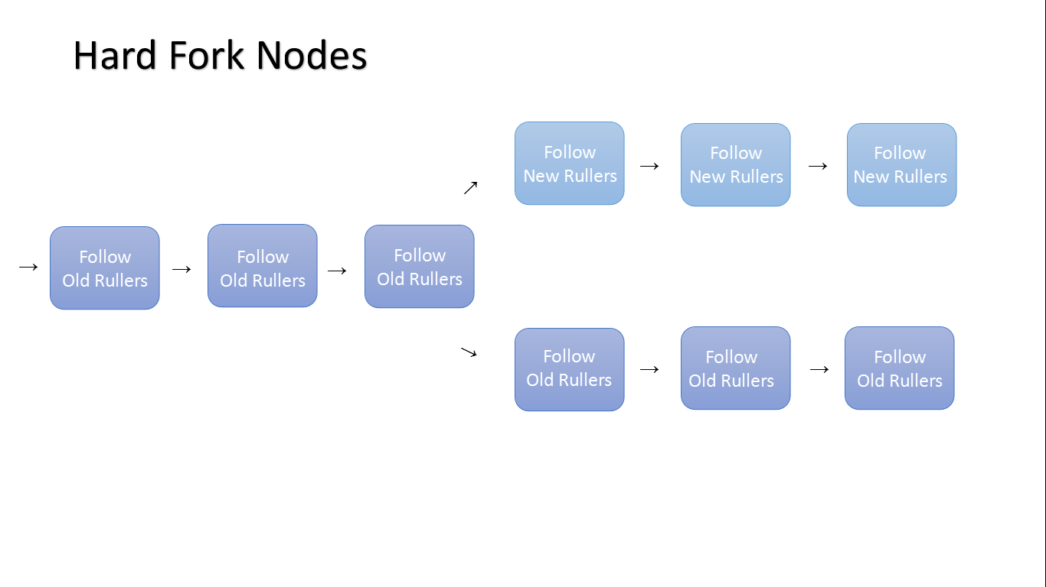
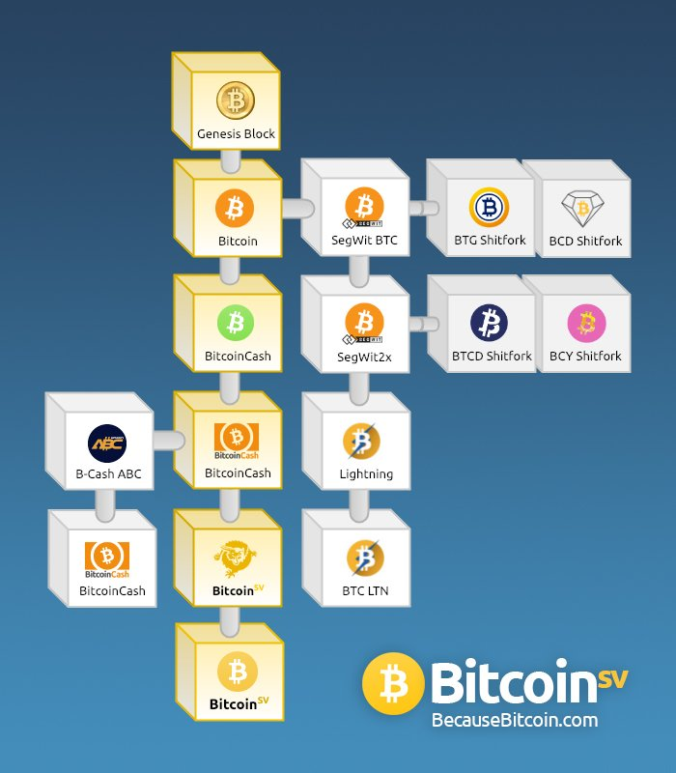
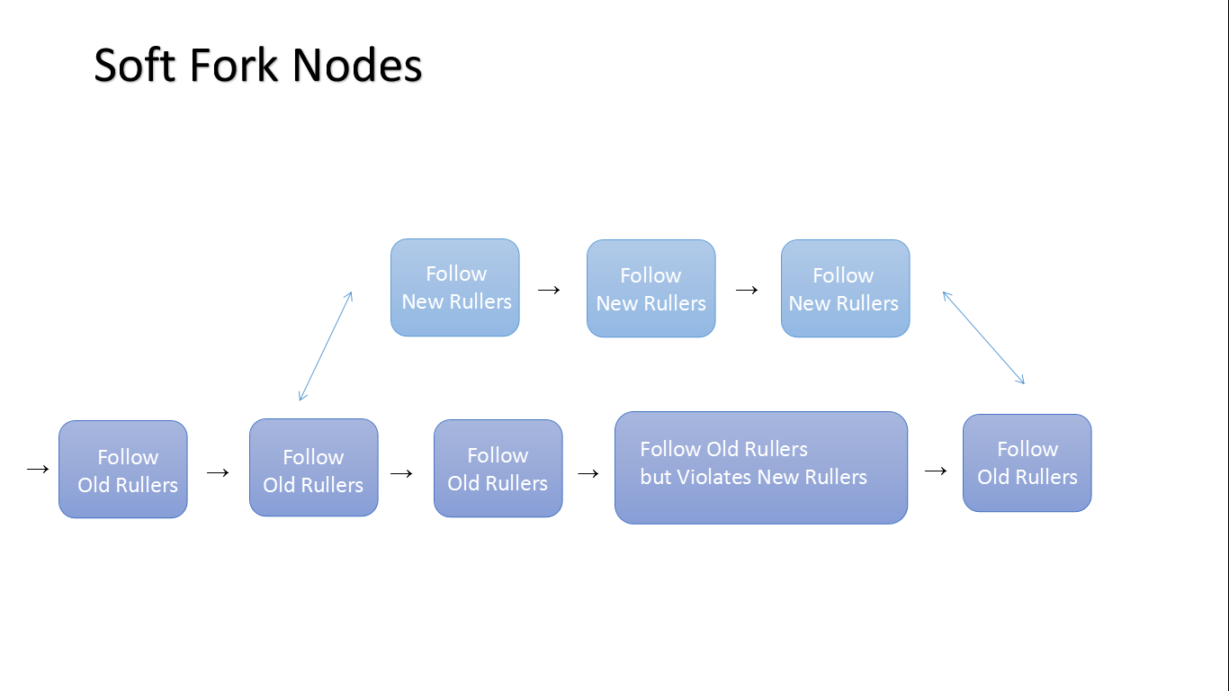
Forks
Blockchain, shaping the future of Internet
Page ‹#›
Notes:
Dani ----- premio
‹#›

Slide 26
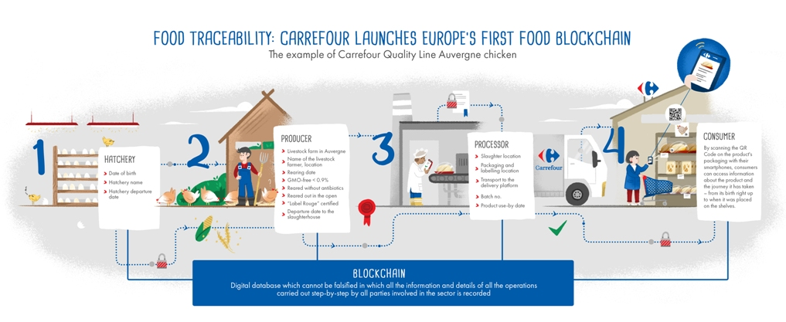
Casos de Uso
Trazabilidad Carrefour
Blockchain, shaping the future of Internet
Page ‹#›
Notes:
Santi
‹#›

Slide 27
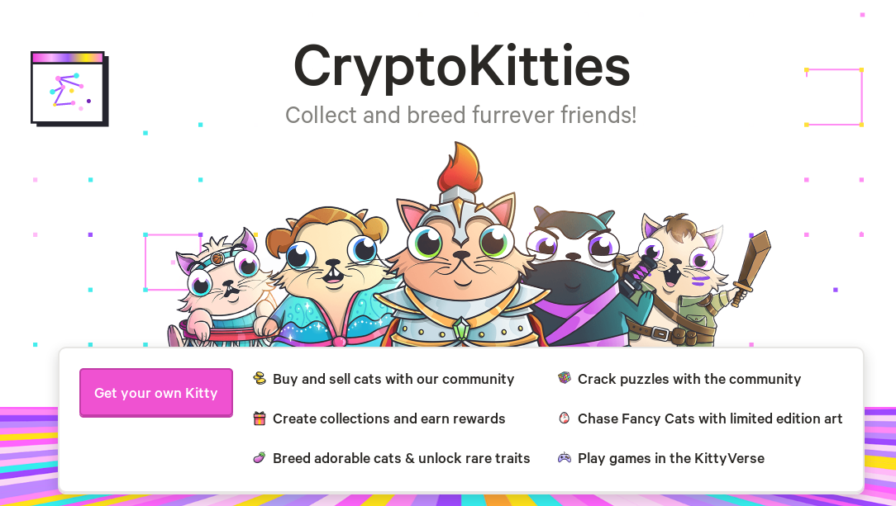
Casos de Uso
CryptoKitties
Blockchain, shaping the future of Internet
Page ‹#›
Notes:
Santi
‹#›

Slide 28

Taller Práctico
Blockchain, shaping the future of Internet

Slide 29
PRÁCTICA
Práctica
Caso de Uso
Crear Smart-Contract
Desplegar Smart-Contract
Comprobar transaccion
Blockchain, shaping the future of Internet
Page ‹#›
Notes:
Jose - https://codeshare.io/
‹#›

Slide 30



PRÁCTICA
Pasajero 1
Usuario del Smart-Contract.
Account asociado.
Una maleta de mano, no tiene que pagar extra.
Práctica
Caso de Uso
Propietario del Smart-Contract.
Account asociado.
Recibe los pagos.
Pasajero 2
Usuario del Smart-Contract.
Account asociado.
Una maleta de mano + maleta facturada (que tendrá sobrecoste).
Blockchain, shaping the future of Internet
Page ‹#›
Notes:
Jose - https://codeshare.io/
‹#›

Slide 31
PRÁCTICA
Crear Smart-Contract
Blockchain, shaping the future of Internet
Page ‹#›
Notes:
Jose - https://codeshare.io/
‹#›

Slide 32
PRÁCTICA
Crear Smart-Contract
http://remix.ethereum.org
https://codeshare.io/
https://git.io/fjqtW
https://solidity.readthedocs.io
Blockchain, shaping the future of Internet
Page ‹#›
Notes:
Jose - https://codeshare.io/
‹#›

Slide 33
PRÁCTICA
Desplegar Smart-Contract
https://metamask.io/
Seleccionar Ropsten Test Framework
Deposit > Test Faucet (GET ETHER)
Request 1 Ether from Faucet
Settings > Security & Privacy > Disable Privacy Mode
Go to Remix > Run > Environment (Injected Web 3)
Deploy!!
Blockchain, shaping the future of Internet
Page ‹#›
Notes:
Jose / Dani - https://codeshare.io/
‹#›

Slide 34
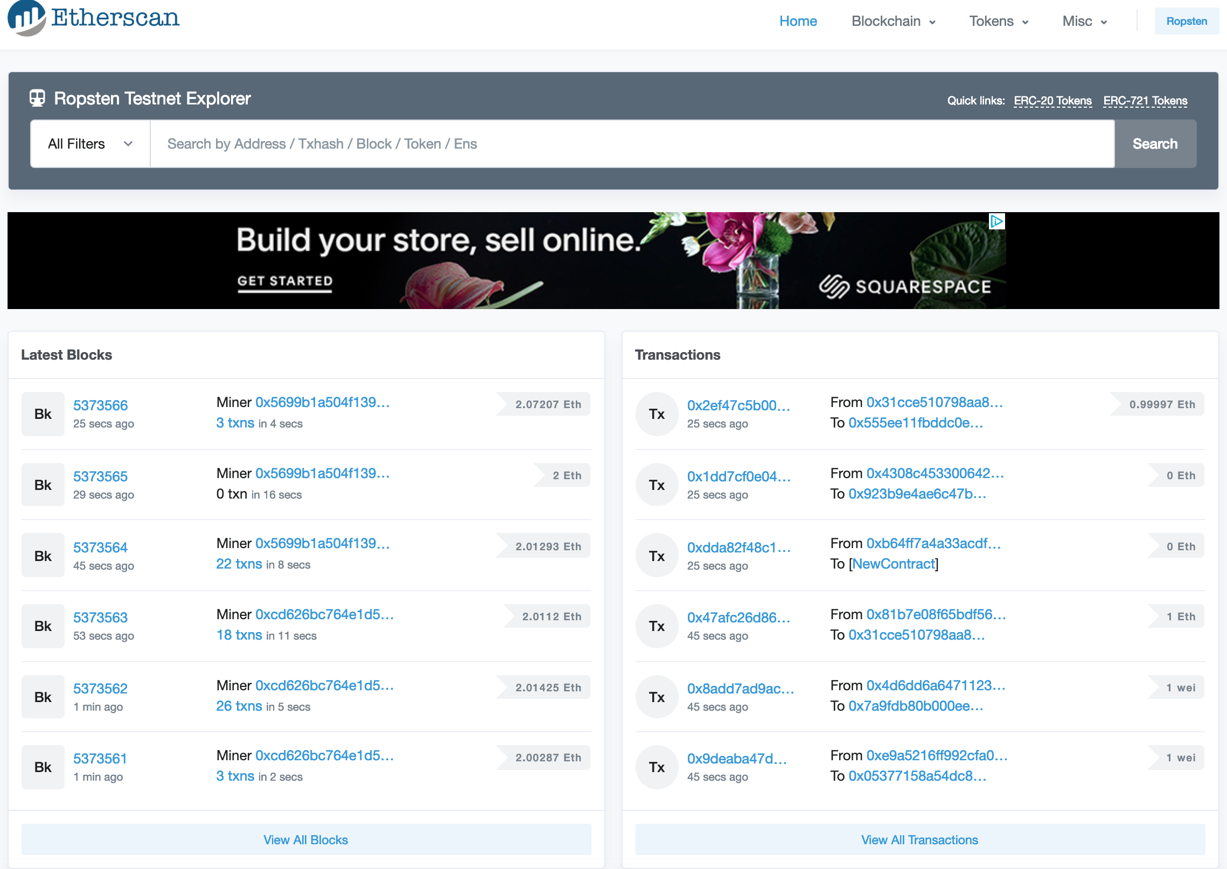
PRÁCTICA
Comprobar Transacciones
https://ropsten.etherscan.io/
Blockchain, shaping the future of Internet
Page ‹#›
Notes:
Jose / Dani - https://codeshare.io/
https://ropsten.etherscan.io
‹#›

Slide 35
Gracias!
Blockchain, shaping the future of Internet
Blockchain, shaping the future of Internet

Slide 36

FEEDBACK
Blockchain, shaping the future of Internet
Page ‹#›
Notes:
‹#›

